Slide 1


Missing data: Is it all the same?
EULAR 2019, Madrid, 12-15 June 2019
Stian Lydersen
Norwegian University of Science and Technology
Methodological advisor, Annals of the Rheumatic Diseases
No conflicts of interest

Slide 2
Missing data:
”Holes” in the data matrix which ideally should be complete
Usually, these are data we intended to collect, but for some reason did not.
There exists a meaningful value which was not recorded.

Slide 3
Type of missing data (Missing data Mechanism) | The probability that a data value is missing (unobserved) can depend on
MCAR Missing Completely at Random | Neither observed nor unobserved values
MAR Missing at Random (Ignorable nonresponse) | Only observed values
MNAR Missing Not at Random (Nonignorable nonresponse) | Unobserved values (and observed values)

Slide 4
Plausibility and implications of MAR
Planned missingness is usually MCAR or MAR
Based on the observed data, there is no way to test if MAR holds. MAR is an unverifiable assumption
In some situations, erroneous assuming MAR has small impact on results. Generally, assuming MAR introduces less bias than assuming MCAR.

Slide 5
Some traditional methods and some recommended methods. (Unbiased when)
Complete case analysis, available case analysis (MCAR)
Single imputation
  Mean substitution (never)
  Averaging available items on a scale (?)
  LOCF (Last Observation Carried Forward) (never)
  Defining «missing» as a data value (never)
  Proper single imputation such as the EM (Expectation-Maximation algortithm) (MAR but underestimates uncertainty)
Multiple Imputation (MI) (MAR)
Full model based analysis (full information maximum likelihood) (MAR)
Linear Mixed model (MAR)

Slide 6
Averaging available items on a scale
Example:
36-Item Short Form Survey (SF-36) is a generic quality of life instrument.
Eight scales with 2 to 10 items each:
  physical functioning
  role limitations due to physical problems
  bodily pain
  general health perceptions
  Vitality
  Social functioning
  role limitations due to emotional problems
  mental health
Recommended in the manual: On each scale, compute the average score if at least 50% of the items are available

Slide 7
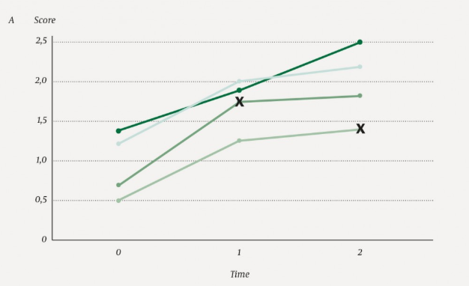
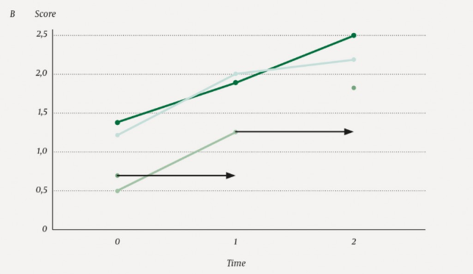
Last observation carried forward (LOCF)
Figure from Lydersen (2019)

Slide 8
Last observation carried forward (LOCF)
Used to be recommended in RCT, believed to be conservative.
But LOCF can give bias in both directions, and can give bias even if data are MCAR.
LOCF is neither valid under general assumptions nor based on statistical principles, and should not be used.
LOCF is attractive because it is simple, but it has little else to recommend it (Vickers and Altman, BMJ, 2013)
See Lydersen (2019) and references therein

Slide 9
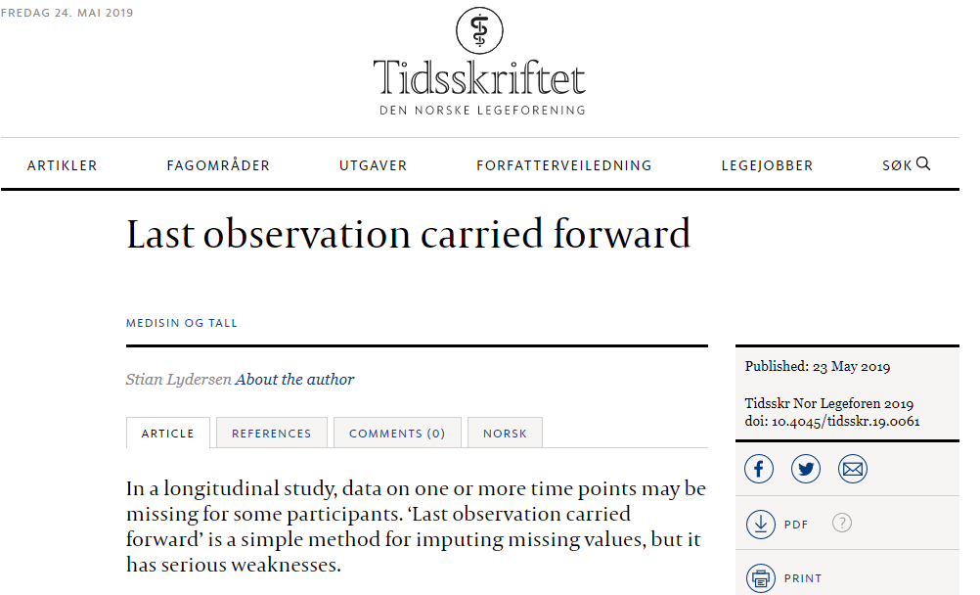

Slide 10
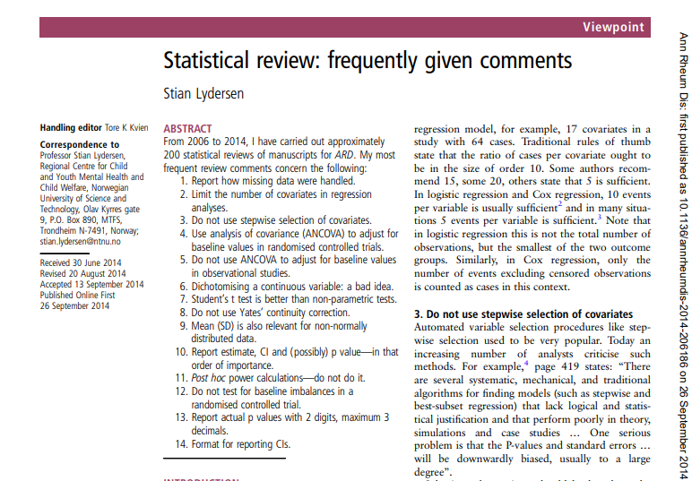
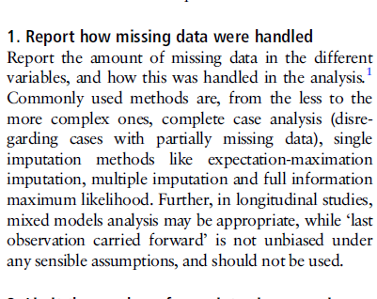
Thank you for your attention

